Slide 1
Data Structure
Linked List
Mohammad Gazi Golam Faruque
Associate Professor
Department of Computer Science and Engineering
KHWAJA YUNUS ALI UNIVERSITY

Slide 2
Related CLOs
Course Learning Outcome (CLO)
CLOs | After successful completing this course, students will be able to. | PLO Mapping
CLO1 | Understand the concept of data structures to apply the algorithm for solving problems. | PO1, PO2
CLO2 | Choose a suitable algorithm to organize the data in several structure in computer. | PO4, PO5
CLO3 | Implement the various data structure algorithm for solving real-life problems. | PO2, PO3
CLO4 | Develop the new sustainable data structure to solve the upcoming problems. | PO12
CLO5 | Explore the various operations of linear, non-linear and dynamic data structures. | PO3, PO12

Slide 3
Discuss Topics
Linked Lists

Slide 4
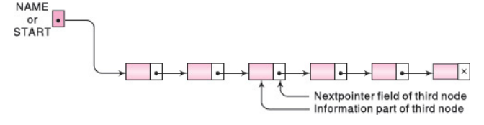
LINKED LISTS
A linked list, or one-way list, is a linear collection of data elements, called nodes, where the linear order is given by means of pointers.
That is, each node is divided into two parts: the first part contains the information of the element, and the second part, called the link field or next pointer field, contains the address of the next node in the list.

Slide 5
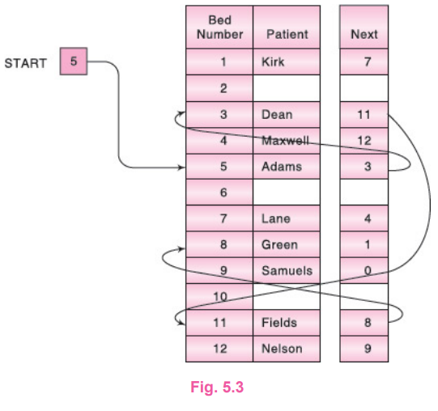
Linked List Examples
A hospital ward contains 12 beds, of which 9 are occupied as shown in Fig. 5.3. Suppose we want an alphabetical listing of the patients. This listing may be given by the pointer field, called Next in the figure. We use the variable START to point to the first patient. Hence START contains 5, since the first patient, Adams, occupies bed 5. Also, Adams’s pointer is equal to 3, since Dean, the next patient, occupies bed 3; Dean’s pointer is 11, since Fields, the next patient, occupies bed 11; and so on. The entry for the last patient (Samuels) contains the null pointer, denoted by 0. (Some arrows have been drawn to indicate the listing of the first few patients.)

Slide 6
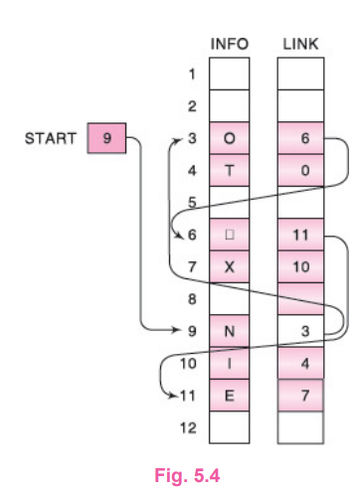
REPRESENTATION OF LINKED LISTS IN MEMORY
Figure 5.4 pictures a linked list in memory where each node of the list contains a single character. We can obtain the actual list of characters, or, in other words, the string, as follows:
START = 9, so INFO[9] = N is the first character.
LINK[9] = 3, so INFO[3] = 0 is the second character.
LINK[3] = 6, so INFO[6] = □ (blank) is the third character.
LINK[6] = 11, so INFO[11] = E is the fourth character.
LINK[11] = 7, so INFO[7] = X is the fifth character.
LINK[7] = 10, so INFO[10] = I is the sixth character.
LINK[10] = 4, so INFO[4] = T is the seventh character.
LINK[4] = 0, the NULL value, so the list has ended.
In other words, NO EXIT is the character string.

Slide 7
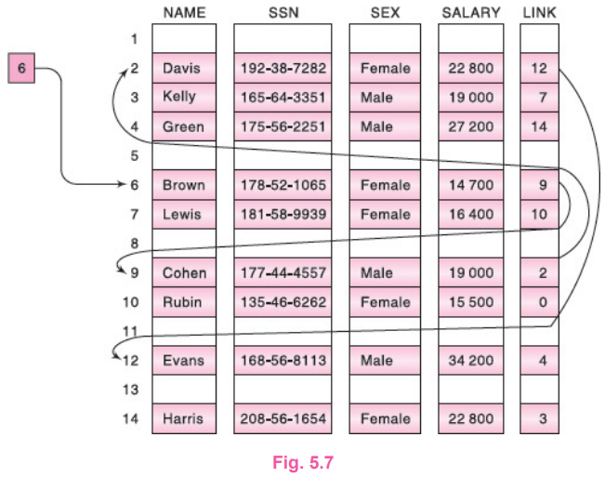
REPRESENTATION OF LINKED LISTS IN MEMORY
Suppose the personnel file of a small company contains the following data on its
nine employees:
Name, Social Security Number, Sex, Monthly Salary
Normally, four parallel arrays, say NAME, SSN, SEX, SALARY, are required to
store the data as discussed in Sec. 4.12. Figure 5.7 shows how the data may be
stored as a sorted (alphabetically) linked list using only an additional array LINK
for the nextpointer field of the list and the variable START to point to the first
record in the list. Observe that 0 is used as the null pointer

Slide 8
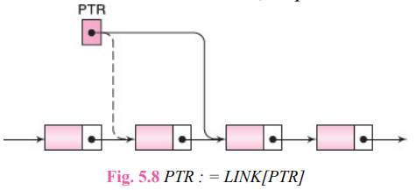
TRAVERSING A LINKED LIST
Let LIST be a linked list in memory stored in linear arrays INFO and LINK with START pointing to the first element and NULL indicating the end of LIST. Suppose we want to traverse LIST in order to process each node exactly once. This section presents an algorithm that does so and then uses the algorithm in some applications.
Our traversing algorithm uses a pointer variable PTR which points to the node that is currently being processed. Accordingly, LINK[PTR] points to the next node to be processed. Thus the assignment
PTR := LINK[PTR]
moves the pointer to the next node in the list, as pictured in Fig. 5.8.

Slide 9
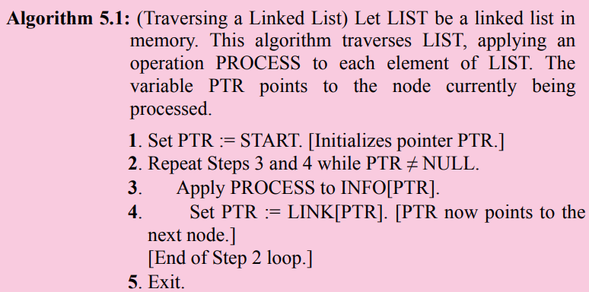
TRAVERSING A LINKED LIST (Algorithm)

Slide 10
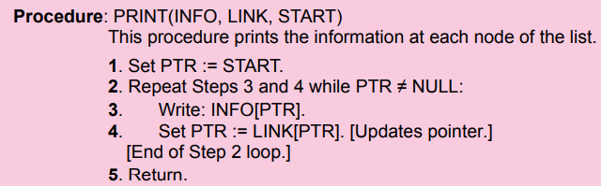
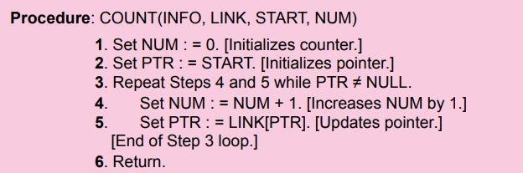
TRAVERSING A LINKED LIST (Algorithm Application)

Slide 11
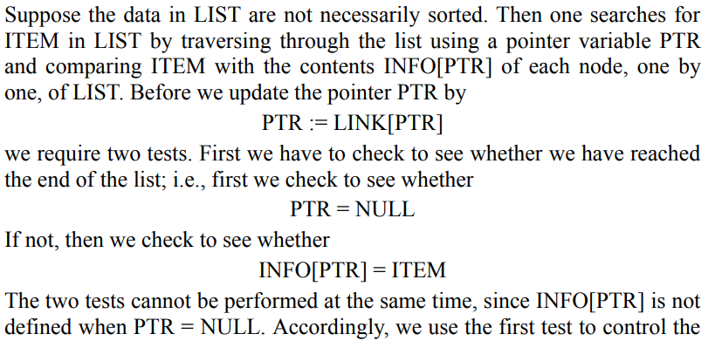
SEARCHING A LINKED LIST
LIST Is Unsorted

Slide 12
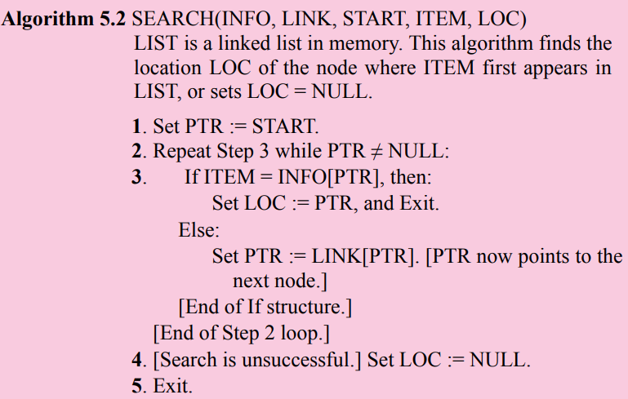
SEARCHING A LINKED LIST (Unsorted)

Slide 13
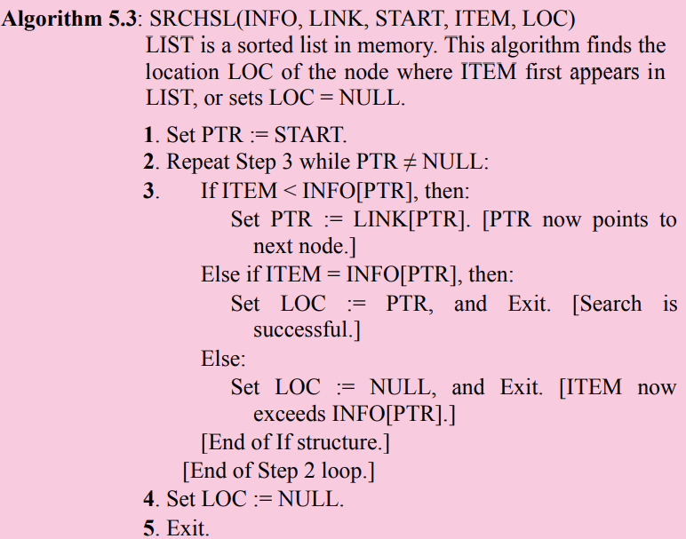
SEARCHING A LINKED LIST (Sorted)

Slide 14
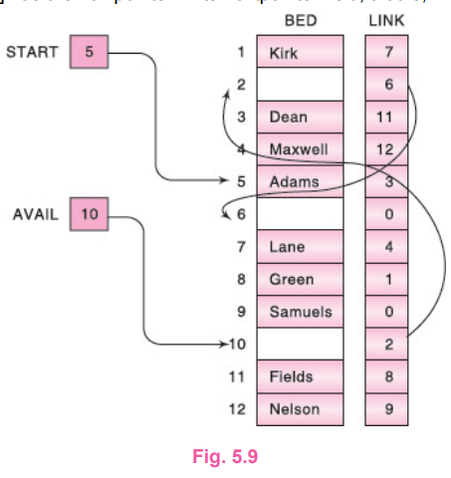
MEMORY ALLOCATION: GARBAGE COLLECTION
Together with the linked lists in memory, a special list is maintained which consists of unused memory cells. This list, which has its own pointer, is called the list of available space or the free-storage list or the free pool.

Slide 15
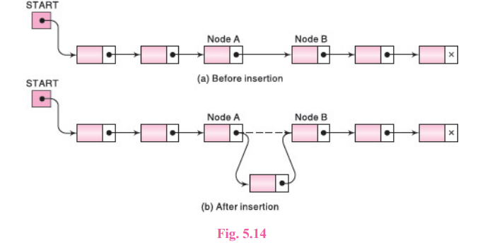
INSERTION INTO A LINKED LIST
Let LIST be a linked list with successive nodes A and B, as pictured in Fig. 5.14(a). Suppose a node N is to be inserted into the list between nodes A and B. The schematic diagram of such an insertion appears in Fig. 5.14(b). That is, node A now points to the new node N, and node N points to node B, to which A previously pointed.

Slide 16
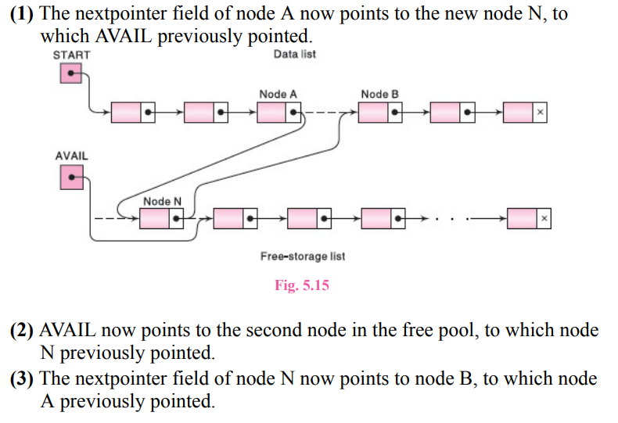
INSERTION INTO A LINKED LIST

Slide 17
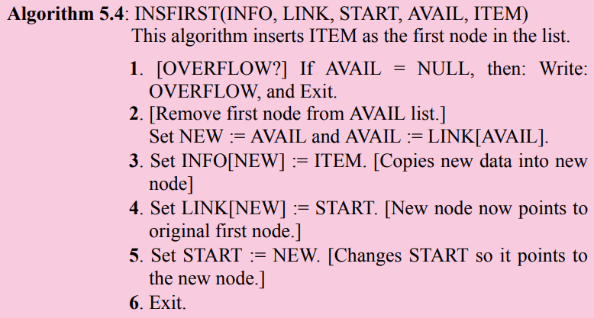
Inserting at the Beginning of a List

Slide 18
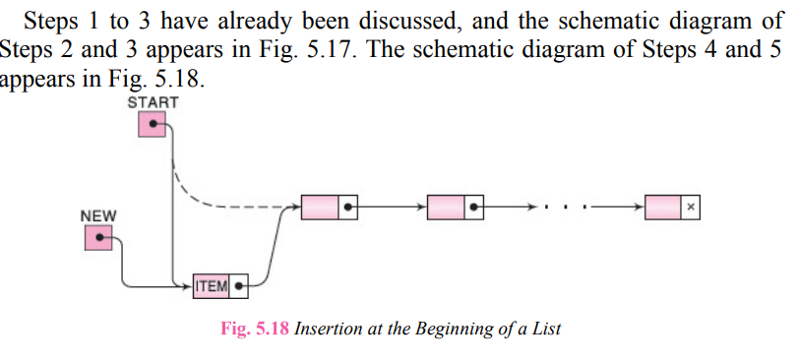
Inserting at the Beginning of a List

Slide 19
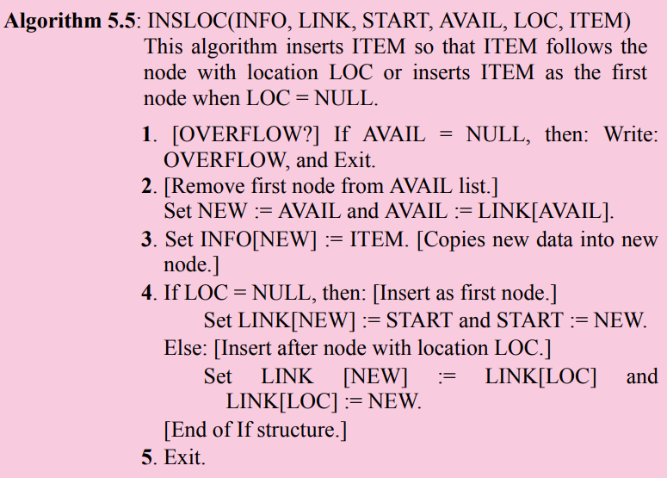
Inserting after a Given Node

Slide 20
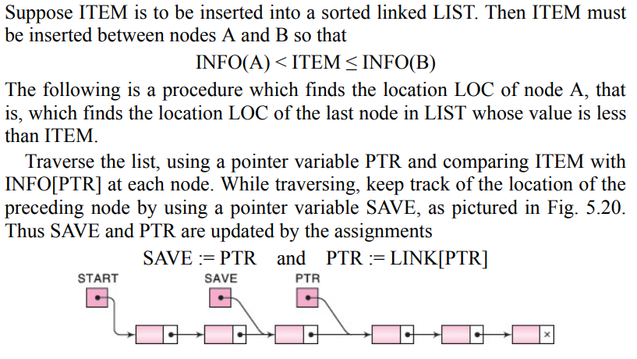
Inserting into a Sorted Linked List

Slide 21
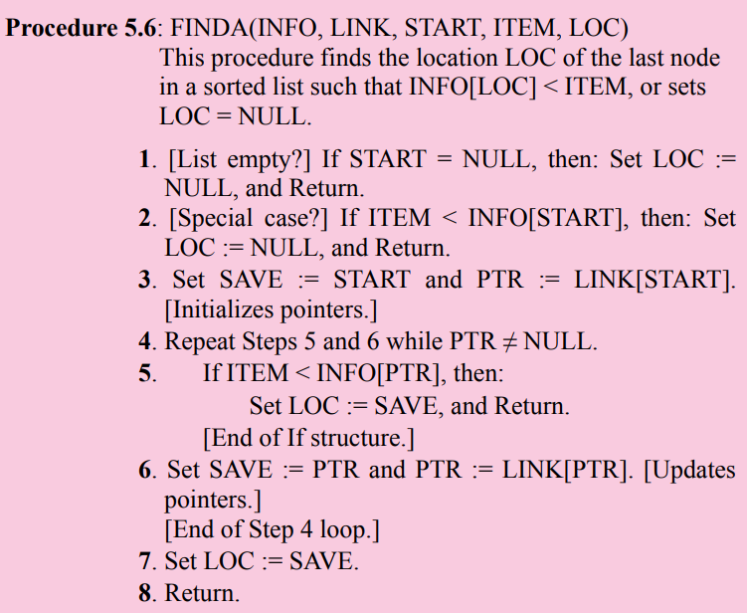

Slide 22
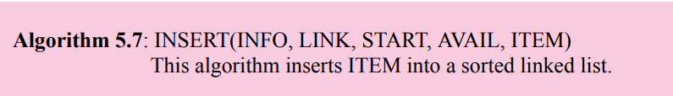
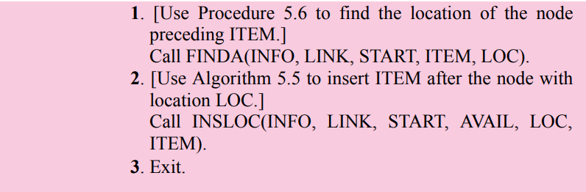
Inserting into a Sorted Linked List

Slide 23
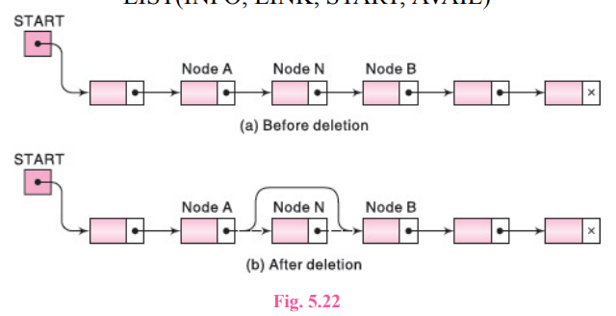
DELETION FROM A LINKED LIST
Let LIST be a linked list with a node N between nodes A and B, as pictured in Fig. 5.22(a). Suppose node N is to be deleted from the linked list. The schematic diagram of such a deletion appears in Fig. 5.22(b). The deletion occurs as soon as the nextpointer field of node A is changed so that it points to node B. (Accordingly, when performing deletions, one must keep track of the address of the node which immediately precedes the node that is to be deleted.)

Slide 24
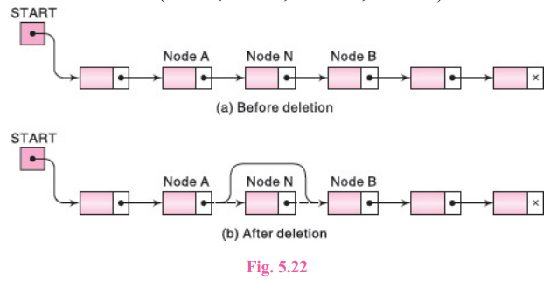
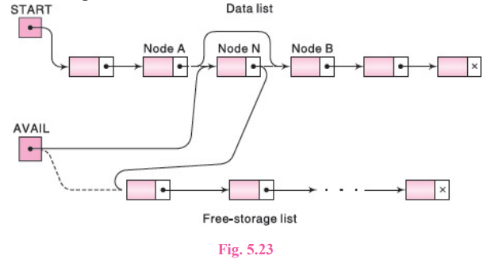
DELETION FROM A LINKED LIST

Slide 25
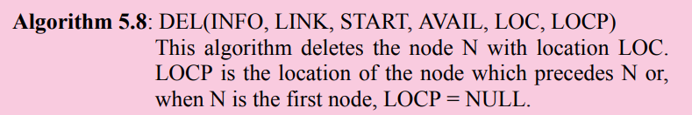
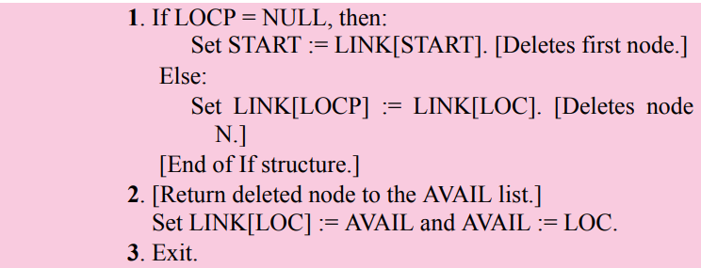
Deleting the Node Following a Given Node

Slide 26
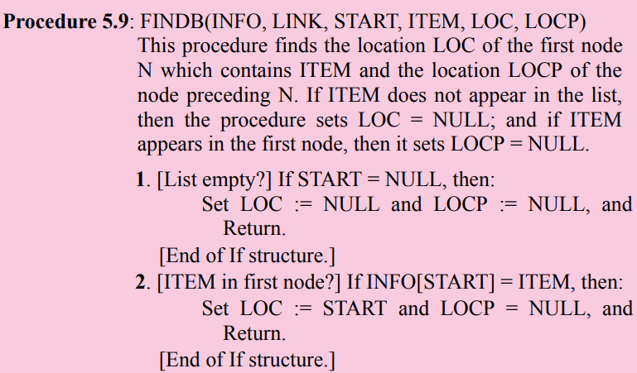
Deleting the Node with a Given ITEM of Information

Slide 27
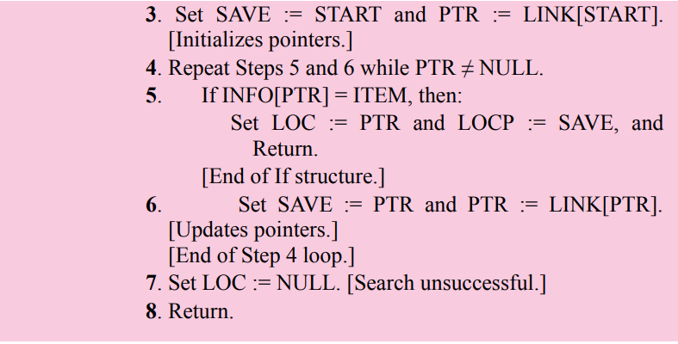
Deleting the Node with a Given ITEM of Information

Slide 28
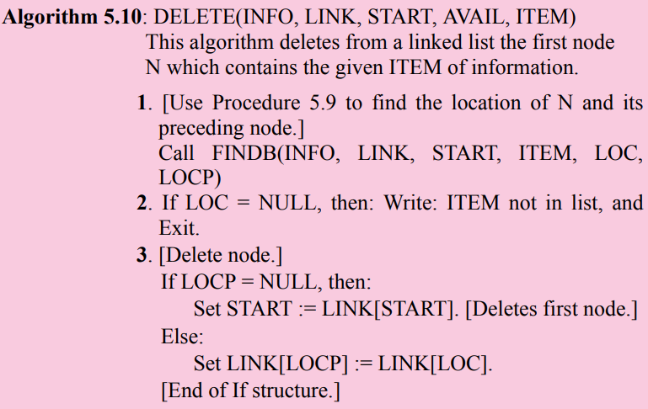

Delete Algorithm

Slide 29
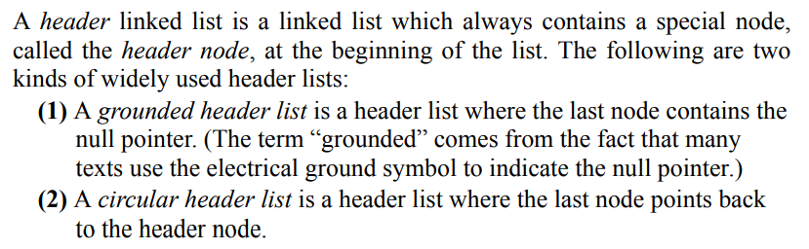
HEADER LINKED LISTS

Slide 30
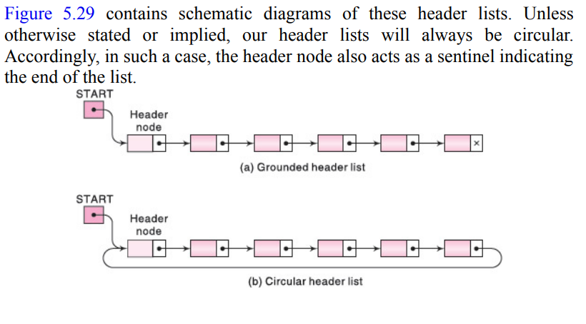
HEADER LINKED LISTS

Slide 31
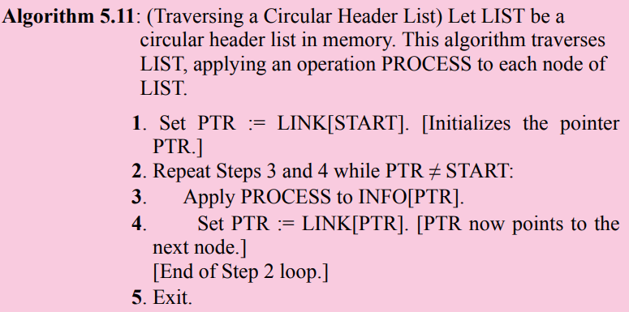
Traversing a Circular Header List

Slide 32
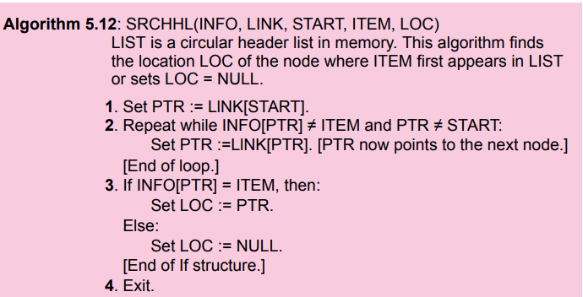
Traversing a Circular Header List

Slide 33
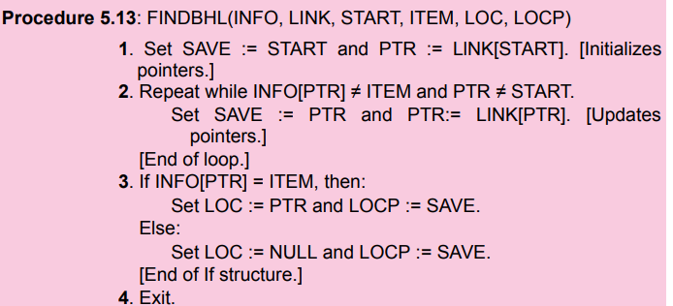
Procedure 5.9 finds the location LOC of the first node N which contains ITEM and also the location LOCP of the node preceding N when LIST is an ordinary linked list. The following is such a procedure when LIST is a circular header list.

Slide 34
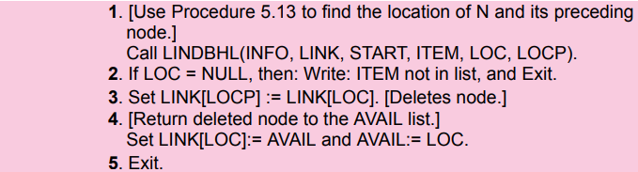
Algorithm 5.10 deletes the first node N which contains ITEM when LIST is an ordinary linked list. The following is such an algorithm when LIST is a circular header list.

Slide 35
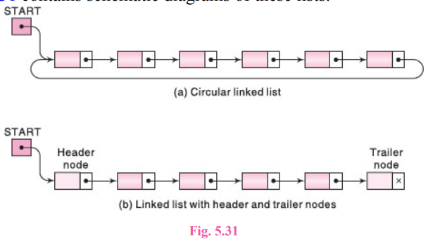
HEADER LINKED LISTS
There are two other variations of linked lists which sometimes appear in the literature:
(1) A linked list whose last node points back to the first node instead of containing the null pointer, called a circular list
(2) A linked list which contains both a special header node at the beginning of the list and a special trailer node at the end of the list
Figure 5.31 contains schematic diagrams of these lists.

Slide 36
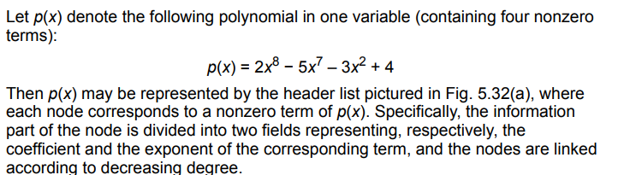
Polynomials
Header linked lists are frequently used for maintaining polynomials in memory. The header node plays an important part in this representation, since it is needed to represent the zero polynomial. This representation of polynomials will be presented in the context of a specific example.

Slide 37
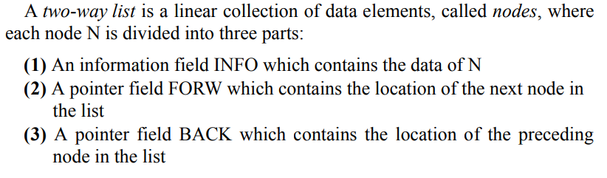
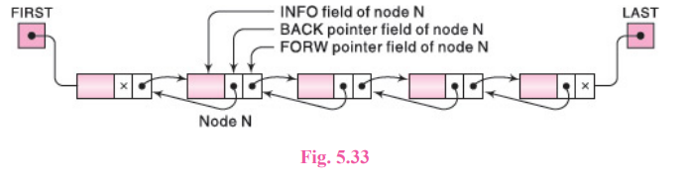
TWO-WAY LISTS

Slide 38
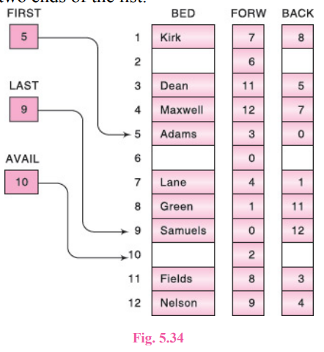
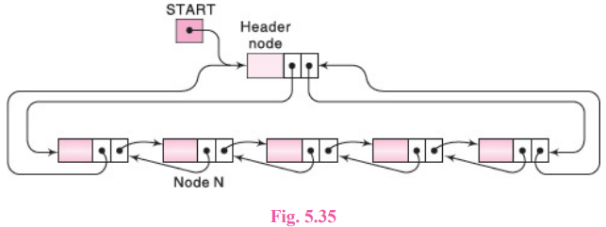
Two-Way Header Lists
The advantages of a two-way list and a circular header list may be combined into a two-way circular header list as pictured in Fig. 5.35. The list is circular because the two end nodes point back to the header node. Observe that such a two-way list requires only one list pointer variable START, which points to the header node. This is because the two pointers in the header node point to the two ends of the list.

Slide 39
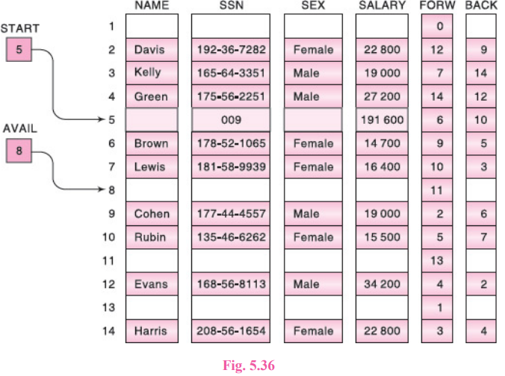

Slide 40
Operations on Two-Way Lists
Traversing : Suppose we want to traverse LIST in order to process each node exactly once. Then we can use Algorithm 5.1 if LIST is an ordinary two-way list, or we can use Algorithm 5.11 if LIST contains a header node. Here it is of no advantage that the data are organized as a two-way list rather than as a oneway list.
Searching : Suppose we are given an ITEM of information—a key value—and we want to find the location LOC of ITEM in LIST. Then we can use Algorithm 5.2 if LIST is an ordinary two-way list, or we can use Algorithm 5.12 if LIST has a header node. Here the main advantage is that we can search for ITEM in the backward direction if we have reason to suspect that ITEM appears near the end of the list. For example, suppose LIST is a list of names sorted alphabetically. If ITEM = Smith, then we would search LIST in the backward direction, but if ITEM = Davis, then we would search LIST in the forward direction.

Slide 41
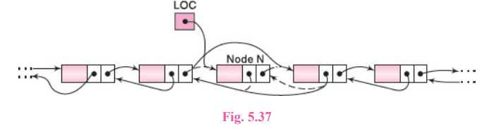
Operations on Two-Way Lists
Deleting: Suppose we are given the location LOC of a node N in LIST, and suppose we want to delete N from the list. We assume that LIST is a two-way circular header list. Note that BACK[LOC] and FORW[LOC] are the locations, respectively, of the nodes which precede and follow node N. Accordingly, as pictured in Fig. 5.37, N is deleted from the list by changing the following pair of pointers:

Slide 42
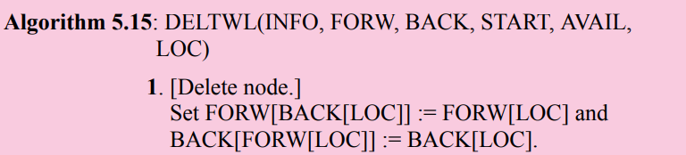

Operations on Two-Way Lists
Deleting a Node from Two-way List

Slide 43
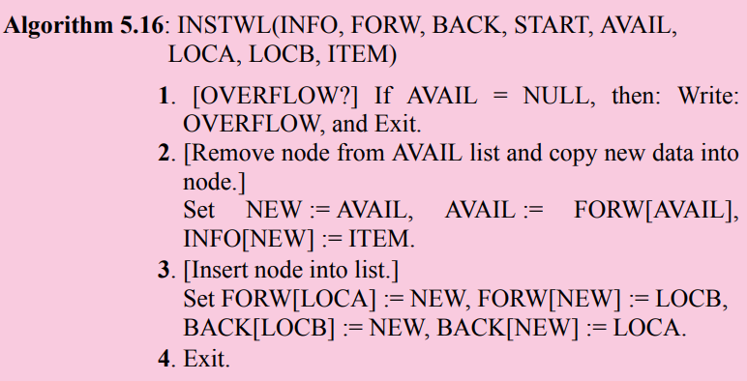
Operations on Two-Way Lists

Slide 44
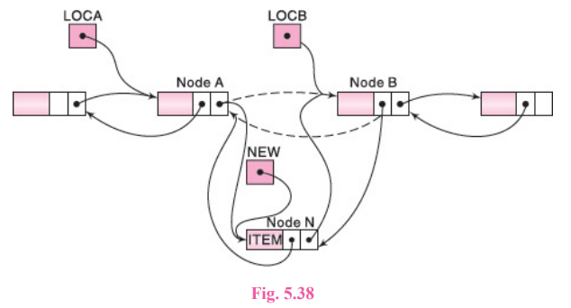
Operations on Two-Way Lists

Slide 45
Important Sample Questions
All exercise from Solved Problems.
All exercise from Supplementary Problems
All exercise from Programming Problems

Slide 46
Next Week Topics
Stacks
Queues and
Recursion

Slide 47
Thank You

